Slide 1

Working with data in Python

Slide 2
Objectives
Use NumPy to create one-dimensional arrays.
The basics and array creation, indexing and slicing, basic operations, universal functions
Use NumPy to create two-dimensional arrays.
The basics and array creation in 2D, indexing and slicing in 2D, and basic operations in 2D
Working with data in Python

Slide 3
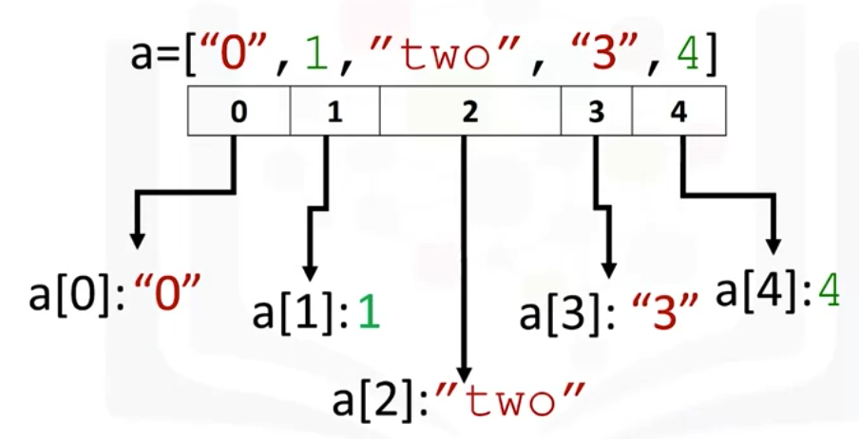
Numpy
Numpy is a library for scientific computing
Numpy is also the basis for pandas.
A numpy array or ND array is similar to a list
Working with data in Python

Slide 4
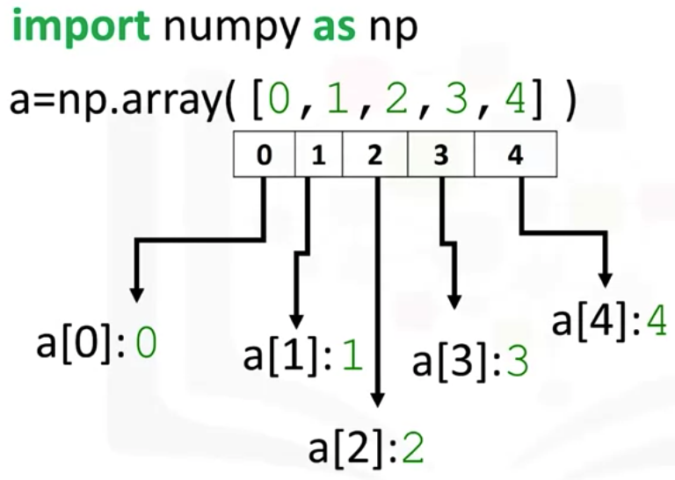
Numpy
Numpy's usually fixed in size and each element is of the same type. We then cast the list as follows; we can access the data via an index.
Working with data in Python

Slide 5
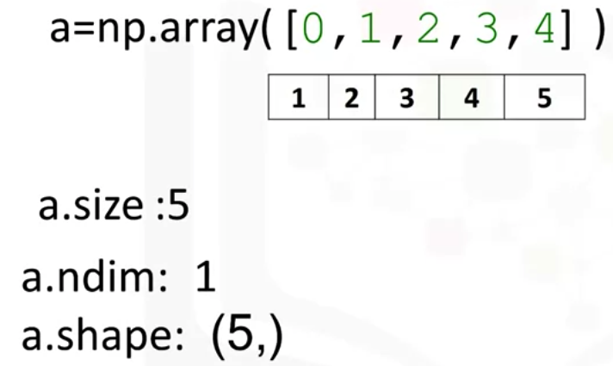
Numpy
The attribute ndim represents the number of array dimensions or the rank of the array, in this case one.
The attribute shape is a tuple of integers indicating the size of the array in each dimension.
Working with data in Python

Slide 6
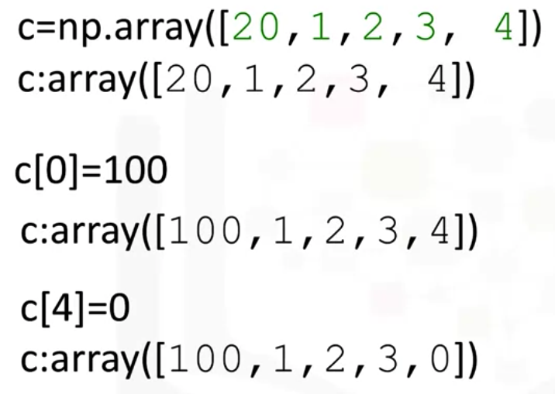
Numpy
Change the value via index
Working with data in Python

Slide 7
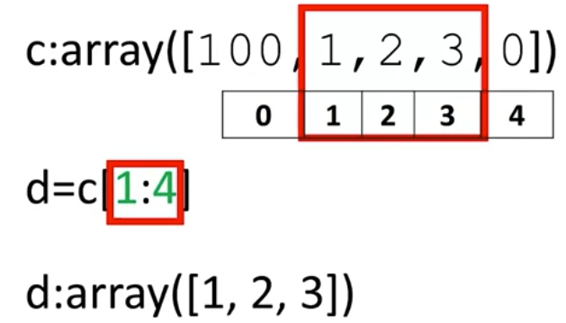
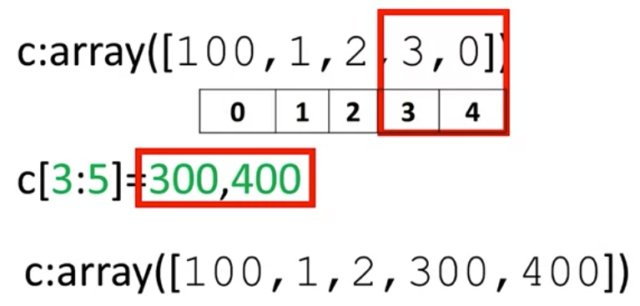
Numpy
Like lists and tuples we can slice a NumPy array
Working with data in Python

Slide 8
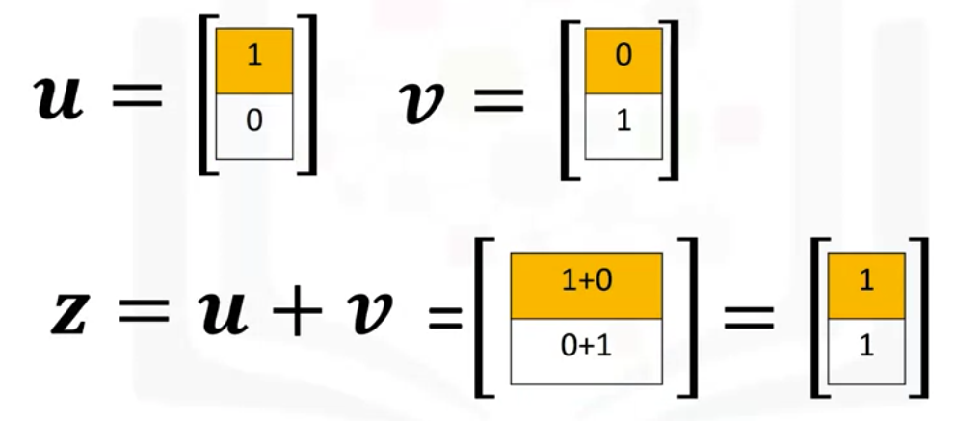
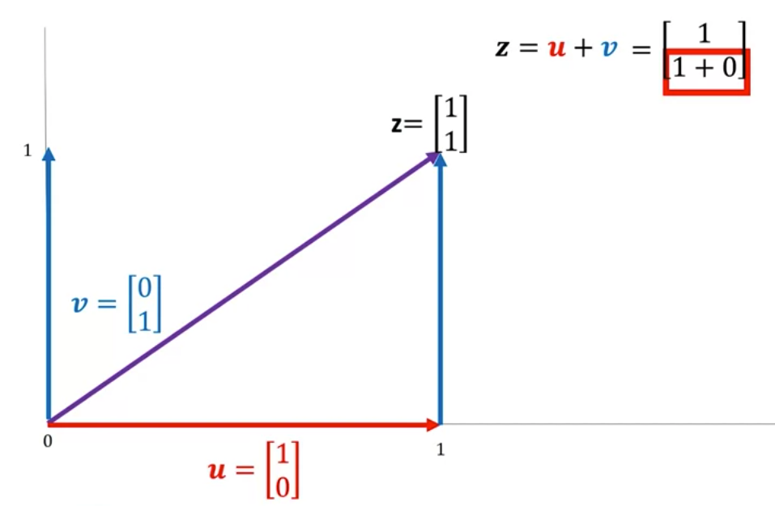
Numpy
Vector addition
Working with data in Python

Slide 9
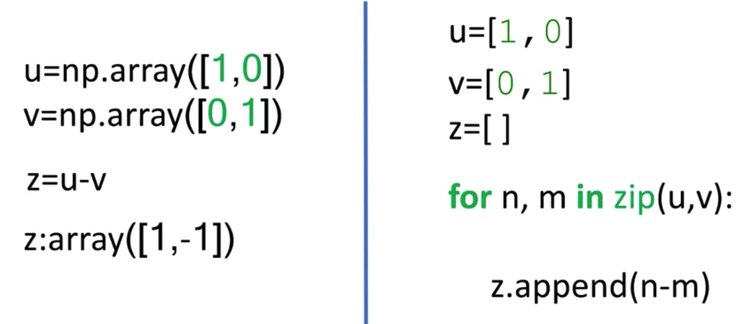
Numpy
Vector Subtraction
Working with data in Python

Slide 10
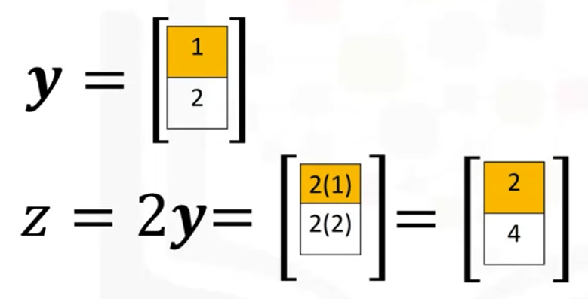
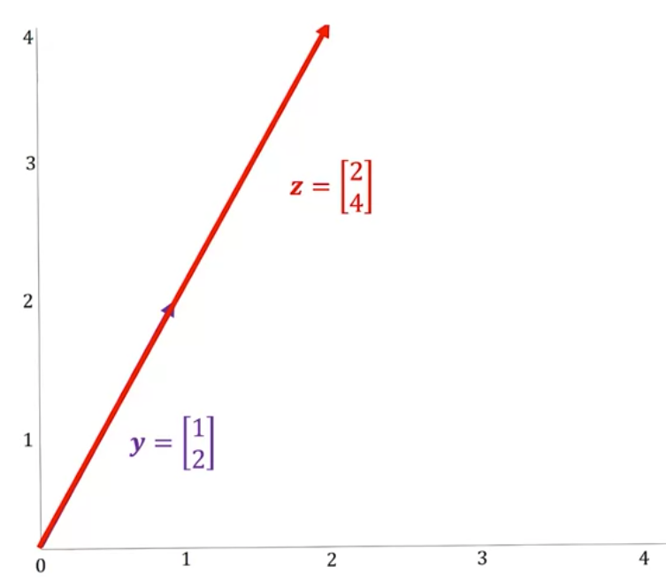
Numpy
Array multiplication with a scalar
Working with data in Python

Slide 11
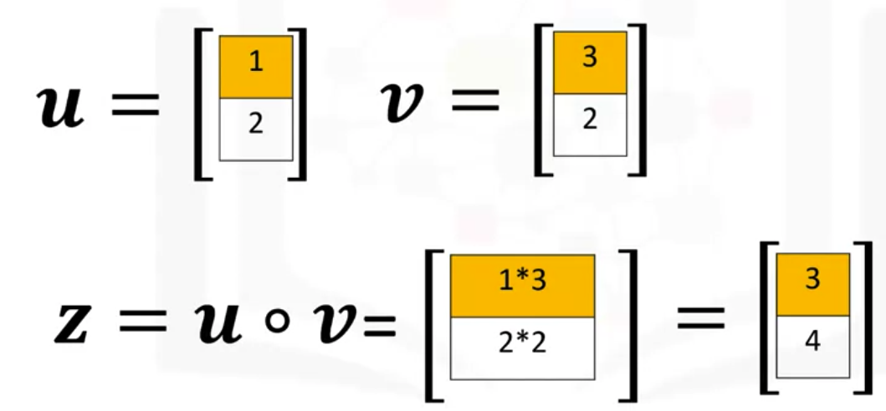
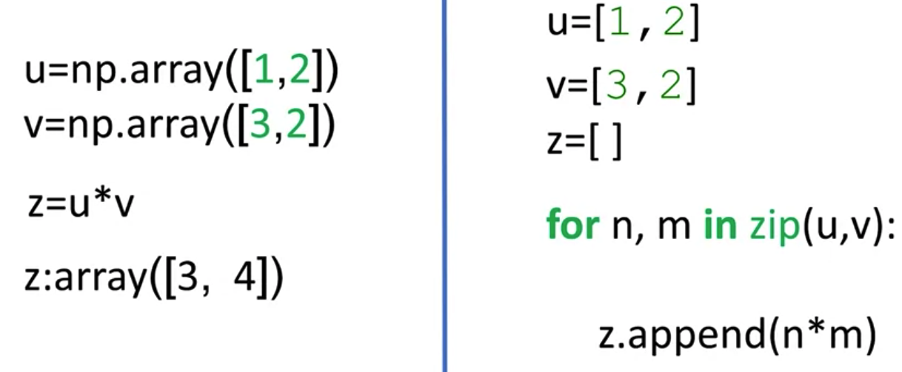
Numpy
Product of two numpy arrays
Working with data in Python

Slide 12
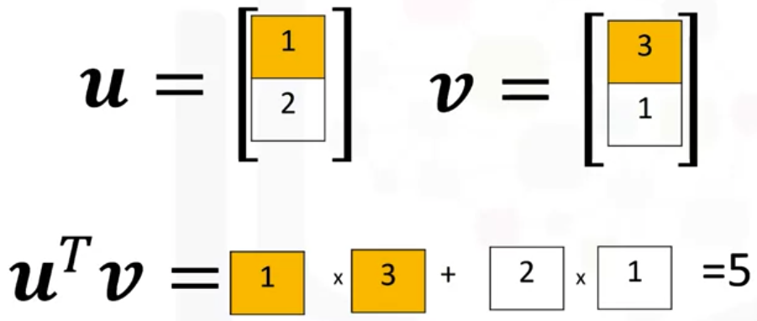
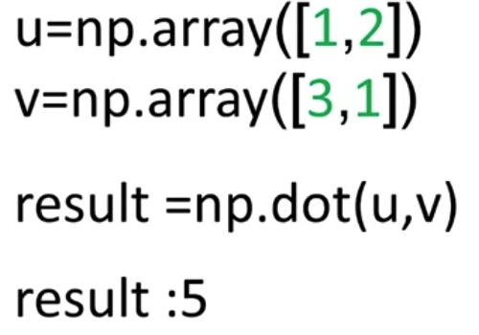
Numpy
Dot product: the dot product is a single number given by the following term and represents how similar two vectors are.
Working with data in Python

Slide 13
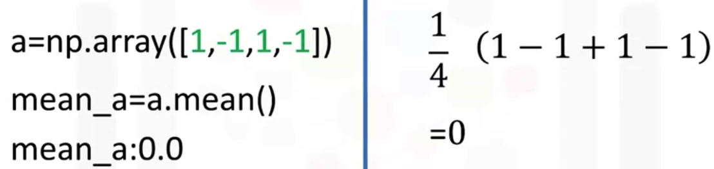
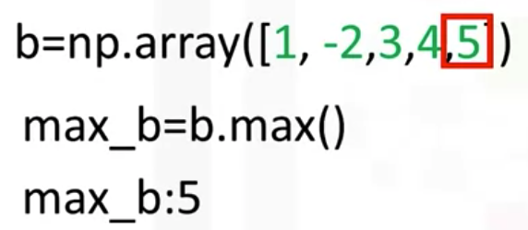
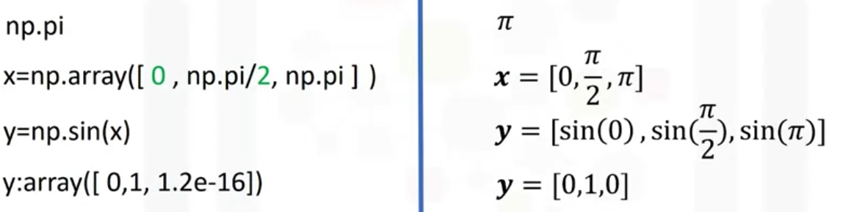
Numpy
mean() function
max() function
pi, sin() function
Working with data in Python

Slide 14
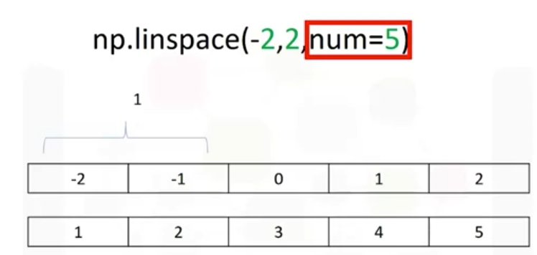
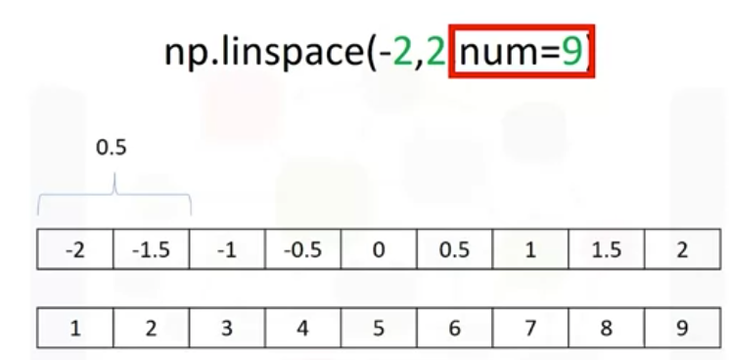
Numpy
Plotting mathematical functions is line space. Line space returns evenly spaced numbers over specified interval
Working with data in Python

Slide 15
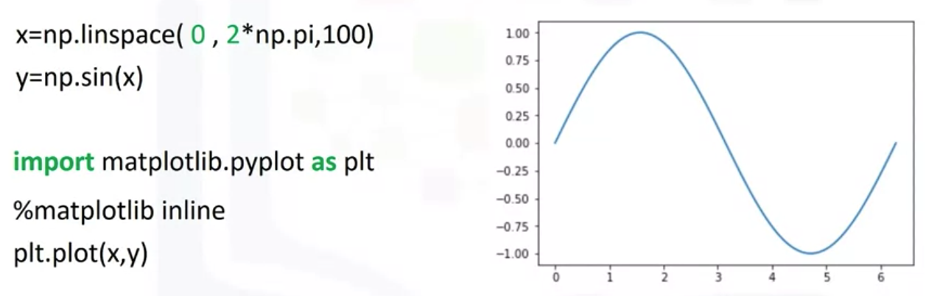
Numpy
Plotting mathematical functions
Working with data in Python

Slide 16
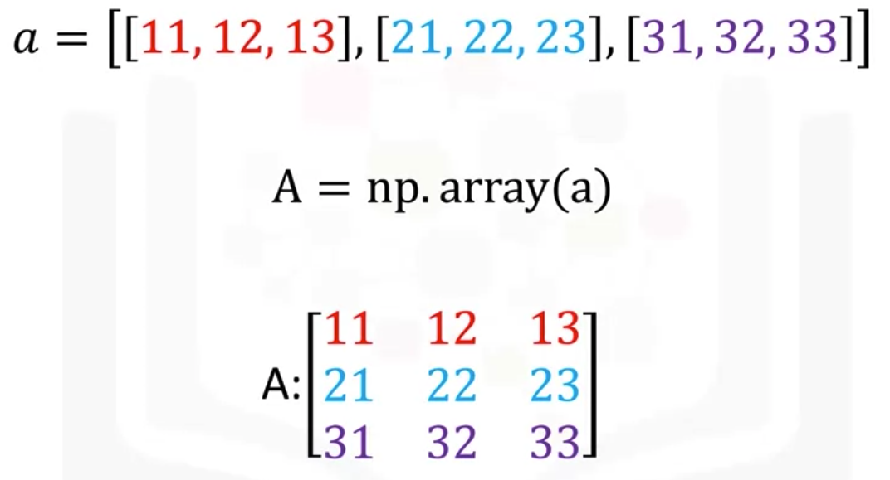
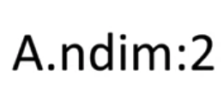
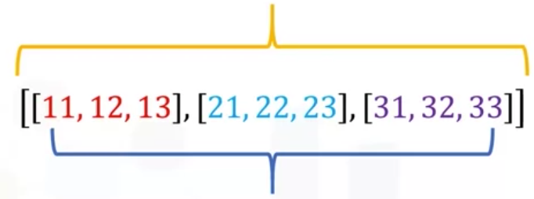
Numpy
The list contains three nested lists each of equal size. We can cast the list to a numpy array as follows.
The first list represents the first dimension.
This represents the second dimension or axis.
Working with data in Python

Slide 17
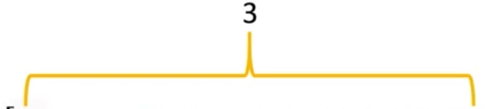


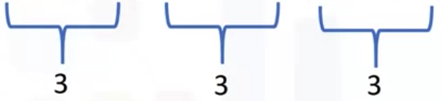

Numpy
The attribute shape returns a tuple.
the attribute size to get the size of the array: in this case nine
Working with data in Python

Slide 18
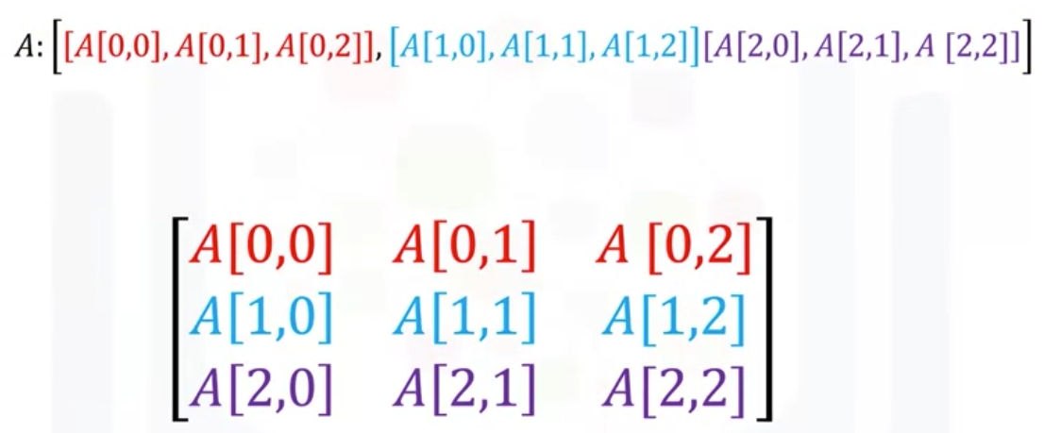
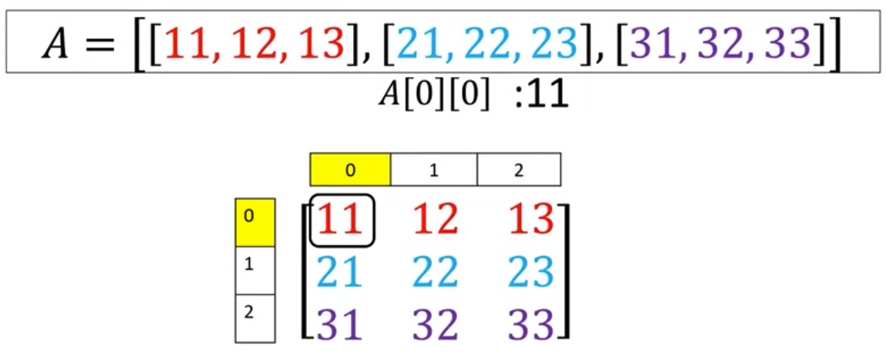
Numpy
Access elements via row and column indexs
Working with data in Python

Slide 19
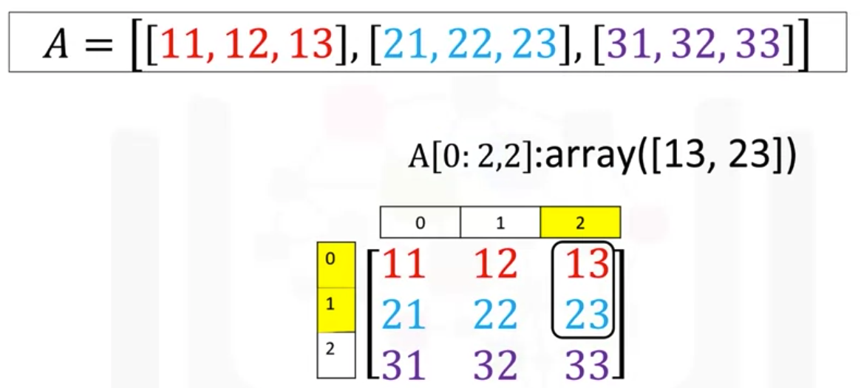
Numpy
We can also use slicing in numpy arrays.
  The first index corresponds to the first row.
  The second index accesses the first two columns.
Working with data in Python

Slide 20
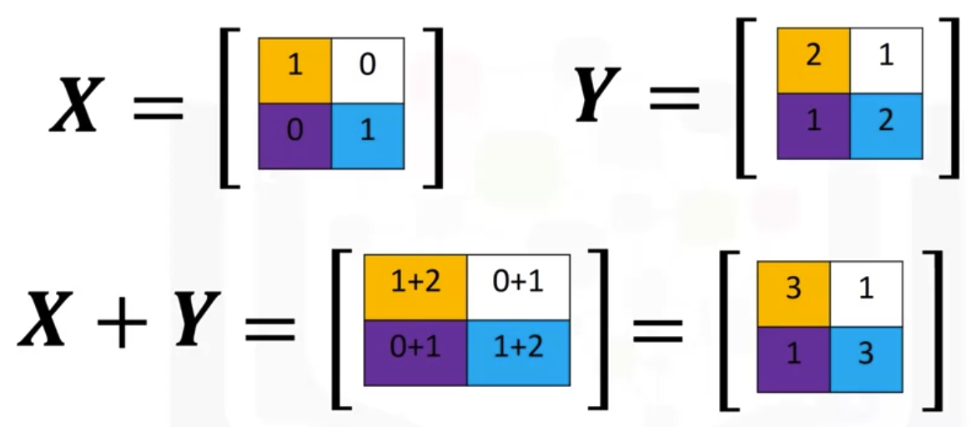
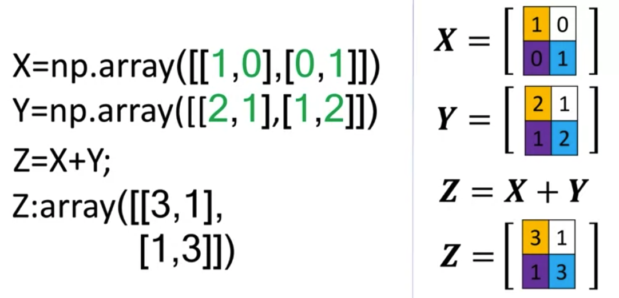
Numpy
Add the matries
Working with data in Python

Slide 21
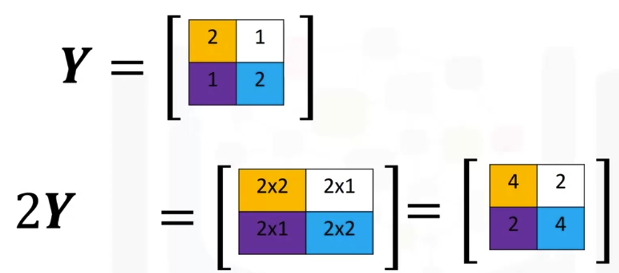
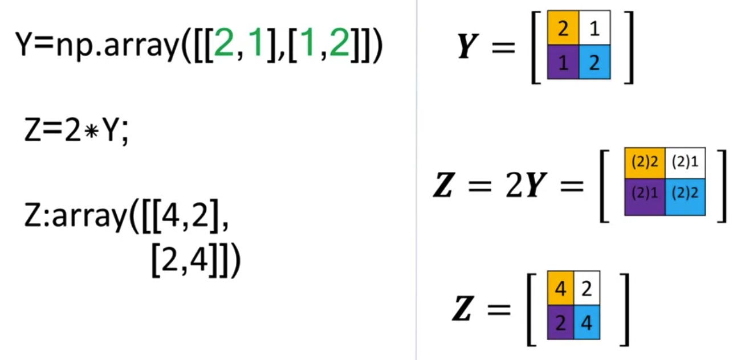
Numpy
Multiplication with a scalar
Working with data in Python

Slide 22
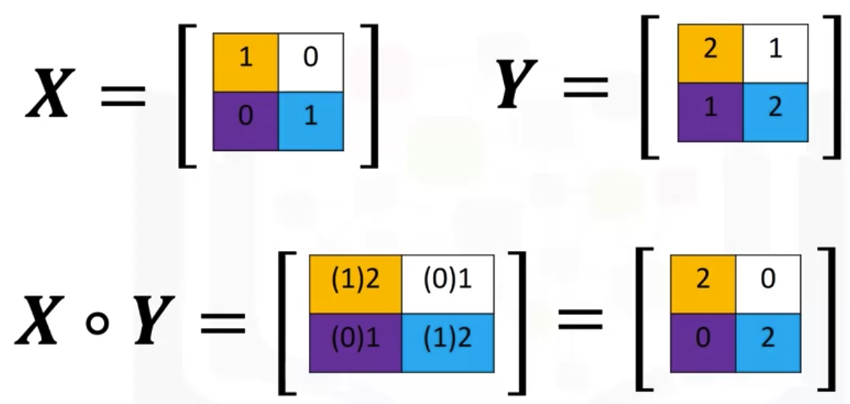
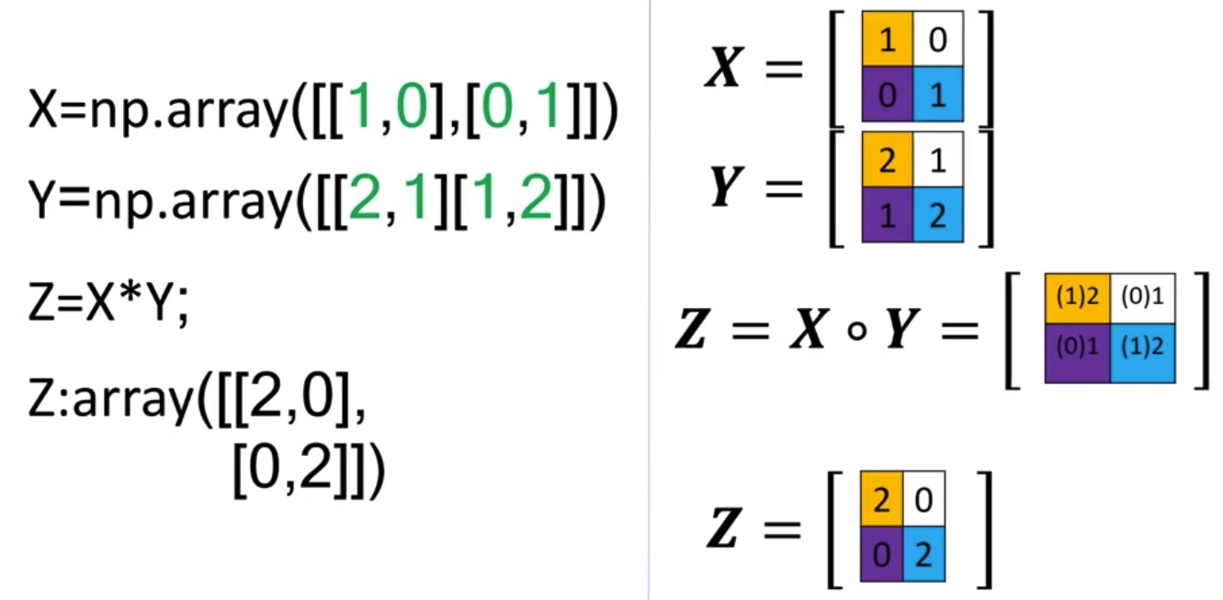
Numpy
Multiplication of two arrays corresponds to an element-wise product, or Hadamard product
Working with data in Python

Slide 23
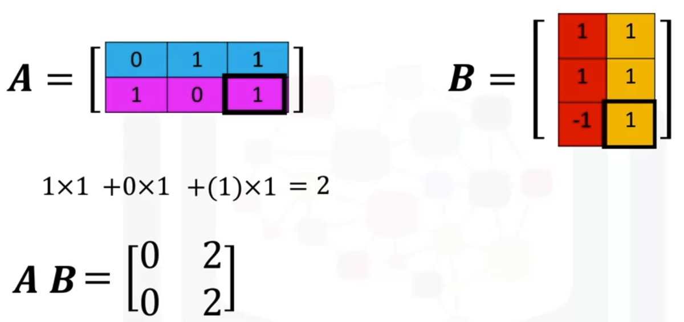
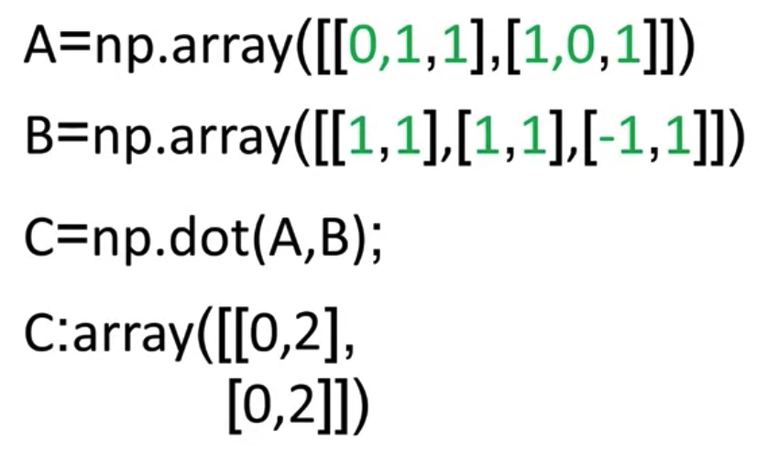
Numpy
We can also perform matrix multiplication with Numpy arrays.
Working with data in Python

Slide 24
Summary
Use NumPy to create one-dimensional arrays.
The basics and array creation, indexing and slicing, basic operations, universal functions
Use NumPy to create two-dimensional arrays.
The basics and array creation in 2D, indexing and slicing in 2D, and basic operations in 2D
Working with data in Python

Slide 25
Q & A
Working with data in Python

